Slide 1
The FFA Emblem

Slide 2
What are the parts of the FFA Emblem?

Slide 3
Cross Section of the Ear of Corn
Corn is a symbol of unity because it is native to America and is grown in every state.

Slide 4
The Rising Sun
The Rising Sun symbolizes progress in agriculture and the confidence FFA members have in the future.

Slide 5
The Eagle
The eagle is a reminder of our freedom and ability to explore new horizons for the future of agriculture

Slide 6
The Owl
The owl represents knowledge and wisdom

Slide 7
The Plow
The plow is the symbol of labor and tillage of the soil

Slide 8
The Words
FFA is an important part of the Agriculture Education Program

Slide 9
The Emblem
Put it all together
Trademark of the National FFA Organization
Be Proud Of It

Slide 10
The Official Colors
The official FFA colors, “national blue” and “corn gold” were adopted in 1929.
The blue was taken from the blue field of our nation's flag.
The gold, however, stems from the golden fields of ripened corn.

Slide 11
The FFA Mission
The FFA makes a positive difference in the lives of students by developing their potential for premier leadership, personal growth, and career success through agricultural education.
Think back to the benefits of FFA we talked about yesterday and list one activity you would like to participate in for each of the 3 mission components.

Slide 12
The FFA Motto
Learning to do,
Doing to learn,
Earning to live
Living to serve
Work with a neighbor to determine what each line of the FFA Motto means

Slide 13
The Official Salute
The Pledge of Allegiance

Slide 14
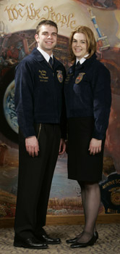
Official Dress – Male
FFA jacket – zipped to the top
Black slacks – no jeans
White button up, collared shirt
Official FFA tie
Black dress shoes
Black socks
No hats

Slide 15
Official Dress – Female
Official FFA Jacket – zipped to the top
Black skirt – knee length, hemmed evenly across the bottom, slit no longer then 2 inches above the knee (slacks may be worn for traveling or outdoor activities)
White button up, collared shirt
Official FFA scarf
Black closed heel and toe dress shoes
Black nylon hosiery

Slide 16
FFA Jacket
State
Name
Office
Year
Chapter

Slide 17
Guidelines for the FFA Jacket
Only FFA members can wear the FFA jacket.
FFA jackets should be kept clean and neat.
The only items on the jacket’s back should be the large emblem, name of the state association, and name of the local chapter. The front of the jacket should include only the small emblem, the member’s name, one office or honor, and the year of that office or honor.
Jackets should be worn with the zipper zipped to the top, collar down and cuffs buttoned.

Slide 18
Guidelines cont.
Jackets should be worn to all official FFA occasions as well as any other occasion where the chapter or state association is represented.
Members should only wear their jacket to places that are appropriate for FFA members to visit.
No school letters or insignia of other organizations are allowed on the jacket.
No more than three pins are allowed on the jacket. Highest degree, highest office, and highest award are worn below the name. State and American degrees are worn above the name or on a chain.

Slide 19
Guidelines cont.
Members should act professionally when wearing the jacket.
Members should refrain from the use of tobacco and alcohol at all times when representing the FFA.

Slide 20
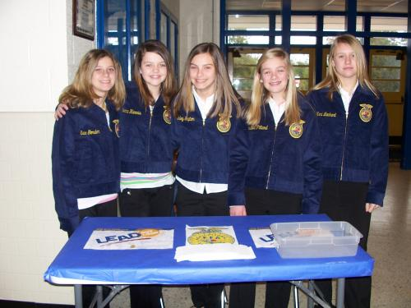

Slide 21
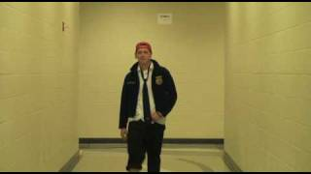

Slide 22
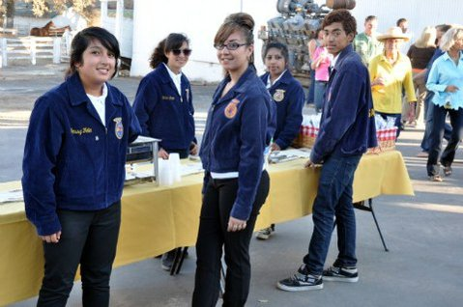

Slide 23
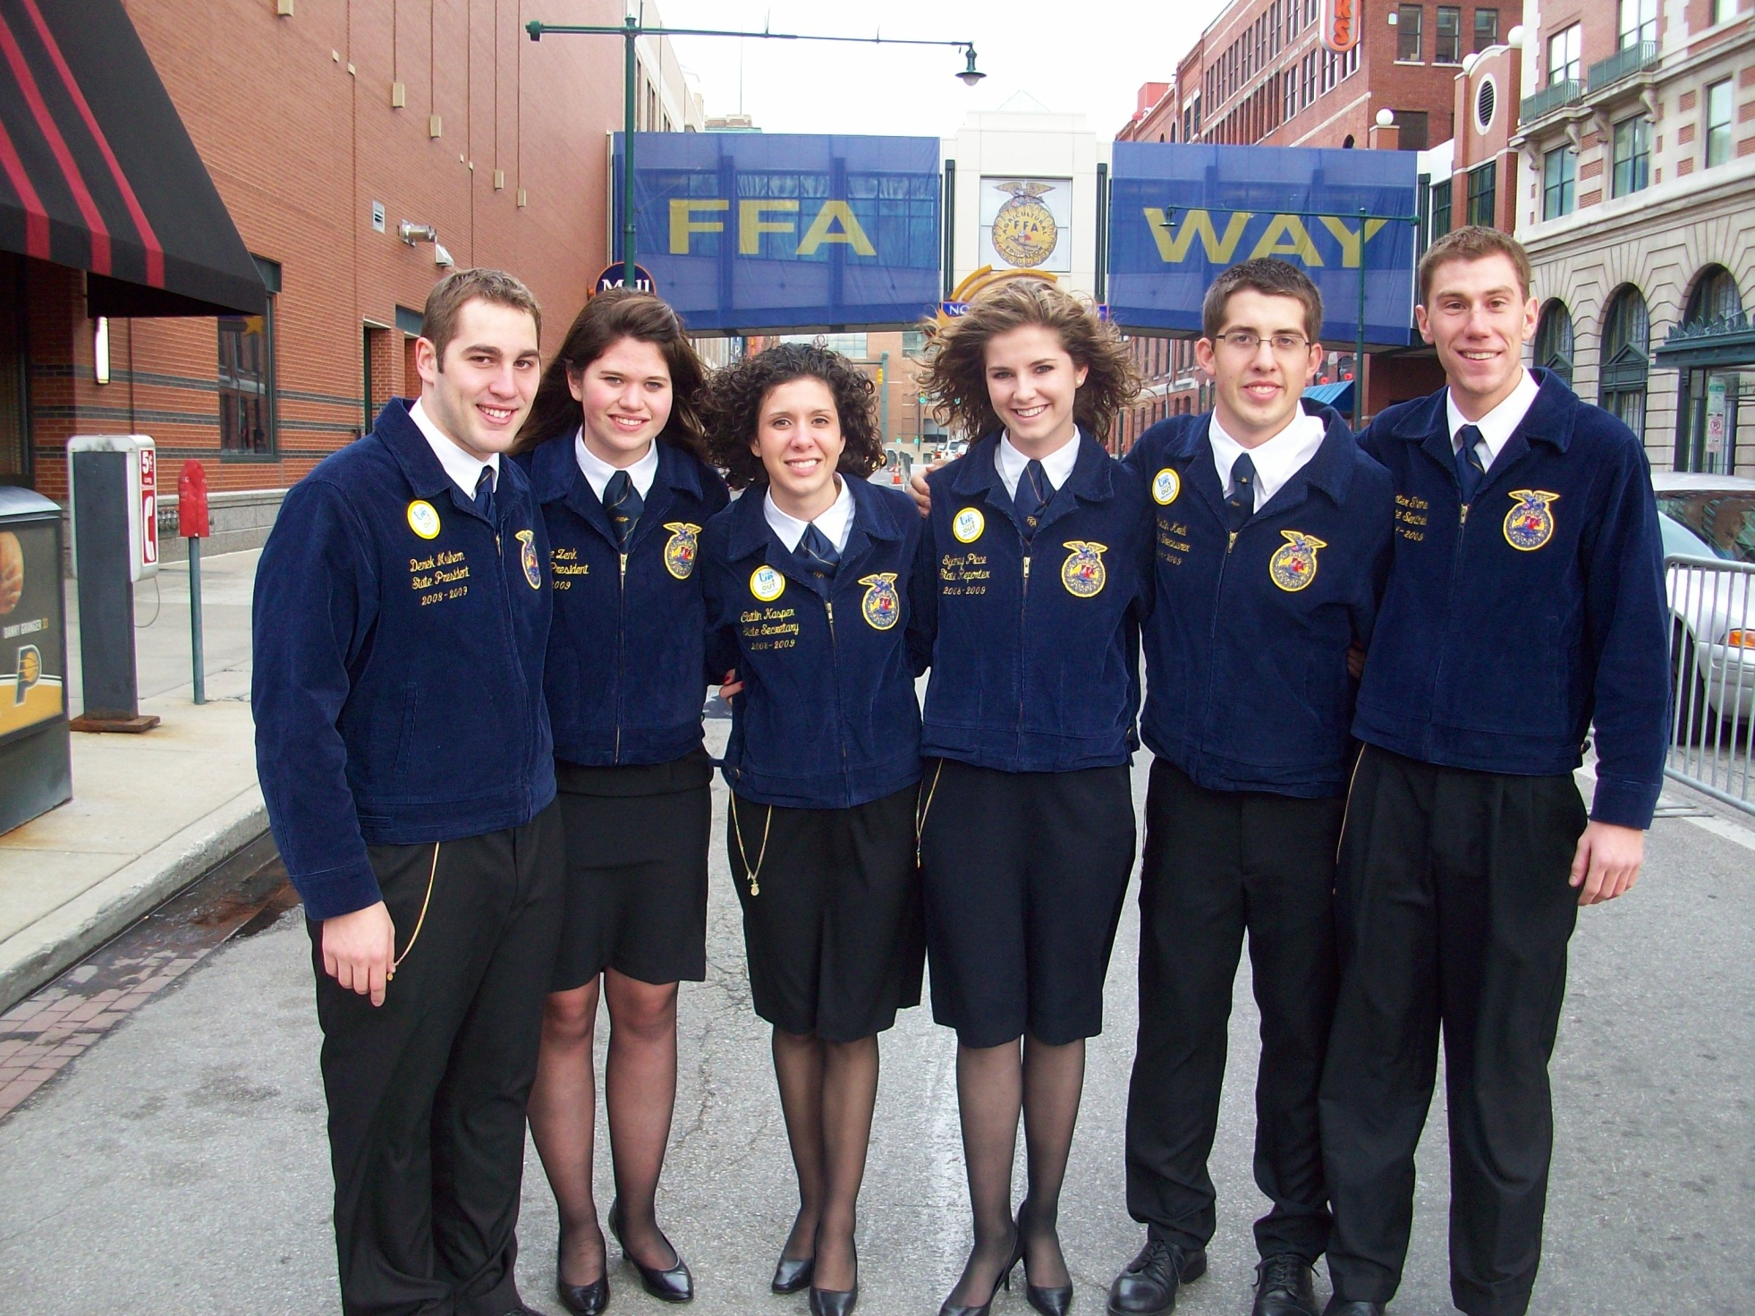

Slide 24
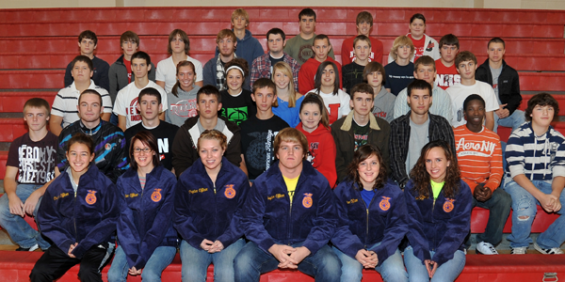

Slide 25
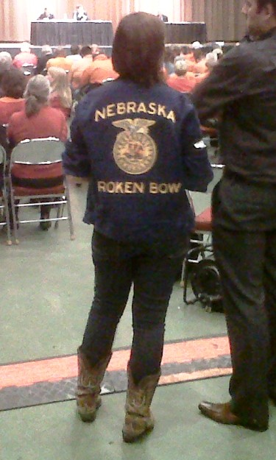

Slide 26
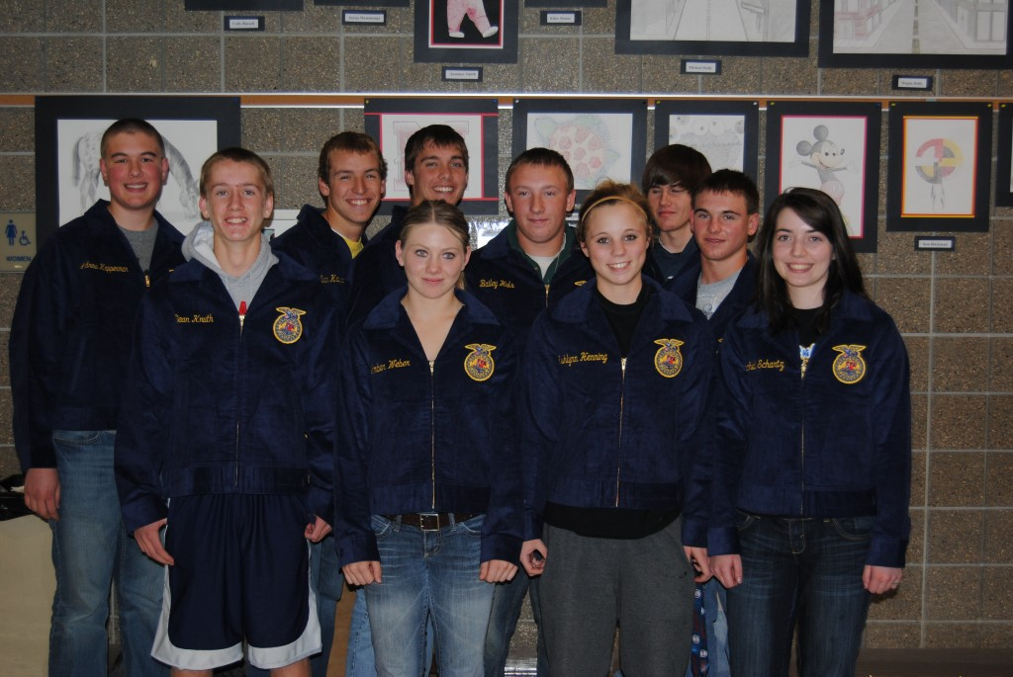

Slide 27
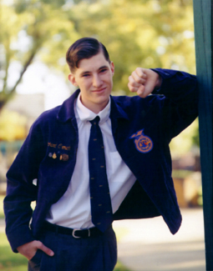

Slide 28
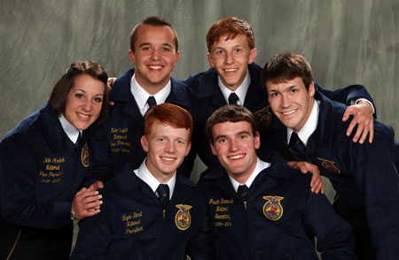

Slide 29
FFA Code of Ethics
We will conduct ourselves at all times in order to be a credit to our organization, chapter, school and community by: -Dressing neatly and appropriately for the occasion. -Showing respect for the rights of others and being courteous at all times. -Being honest and not taking unfair advantage of others. -Respecting the property of others. -Refraining from loud, boisterous talk, swearing and other unbecoming conduct.

Slide 30
FFA Code of Ethics
-Demonstrating sportsmanship in the show ring, judging contests and meetings. -Being modest in winning and generous in defeat. -Attending meetings promptly and respecting the opinion of others in discussion. -Taking pride in our organization, activities, supervised experience program, exhibits, and the occupation of agriculture. -Sharing with others experiences and knowledge gained by attending national and state meetings. -Striving to establish and enhance my skills through agricultural education in order to enter a successful career. -Appreciating and promoting diversity in our organization.

Slide 31
4 Types of FFA Membership
Active
Collegiate
Alumni
Honorary

Slide 32
Degrees
Discovery
Greenhand
Chapter
State
American

Slide 33
Discovery
Available to 7th and 8th grade members
**Not required for subsequent degrees**
Requirements
Be enrolled in an ag ed class
Pay FFA dues
Participate in at least one local FFA activity
Have a knowledge of agriculture careers
Be familiar with the local POA
Submit a written application

Slide 34
Greenhand
Be enrolled in agricultural education and have plans for an SAE.
Learn and explain the FFA Creed, Motto, Salute and FFA Mission Statement.
Explain the meaning of the FFA emblem and colors.
Demonstrate a knowledge of the FFA Code of Ethics and the proper use of the FFA jacket.
Demonstrate a knowledge of the history of the organization, the chapter constitution and bylaws, and the chapter Program of Activities.
Personally own or have access to the Official FFA Manual and the FFA Student Handbook.
Submit written application.

Slide 35
Chapter
Must have received the Greenhand FFA Degree.
Must have satisfactorily completed the equivalent of at least 180 hours of systematic school instruction in agricultural education at or above the ninth grade level, have in operation an approved supervised agricultural experience program, and be enrolled in an agricultural education course.
Have participated in the planning and conducting of at least three official functions in the chapter Program of Activities.
Have earned and productively invested at least $150 by the member's own efforts or worked at least forty-five hours in excess of scheduled class time, or a combination thereof, and have developed plans for continued growth and improvement in a supervised agricultural experience program.

Slide 36
Chapter cont.
Have effectively led a group discussion for 15 minutes.
Have demonstrated five procedures of parliamentary law.
Show progress toward individual achievement in the FFA award programs.
Have a satisfactory scholastic record.
Submit a written application for the Chapter FFA Degree.

Slide 37
State
Must have received the chapter degree.
Must have been an active member for at least two years
Have completed at least 24 months (360 hours) of agricultural education instruction with an SAE.
Earned and productively invested at least $1000 or worked at least 300 hours in their SAE.
Perform 10 procedures of parliamentary law.
Given a 6 minute speech on an agricultural topic.
Served as an officer or committee chairperson.

Slide 38
State cont.
Has participated in at least 8 activities above the chapter level
Have a satisfactory academic record
Participated in the planning and completion of the chapter program of activities

Slide 39
American
Have received the state FFA degree
Have been an active member for the past 3 years
Have a record of participating in activities on the chapter and state level
Have completed at least 3 years of high school agricultural education instruction
Graduated from high school at least 12 months prior to the national convention at which the degree is awarded

Slide 40
American cont.
Have a supervised agricultural experience
Have earned and productively invested at least $7500 or at least $1500 and worked 2250 hours
Have a high school scholastic record or C or better

